Slide 1
Project-2 RDBMS for statistics in Cricket
Team 4
Amit Fernandes
Izhar Raazi
Sarthak Raste
Keertikeya Gupta

Slide 2
Problem
To make a database management system for sports statistics for the game of Cricket.
This system will allow users to view the individual statistics of players, match details, stats of teams and other stats such as leader-boards and records.
Administrator of the system can manage the data within the system, and perform functions such as addition, update, and deletion of data.

Slide 3
Assumptions
Each Player plays for only one country.
The name of a player is unique in each team, however player with same name may play for different team.
Only 11 players will play for each team.
Each team will have only one coach.

Slide 4
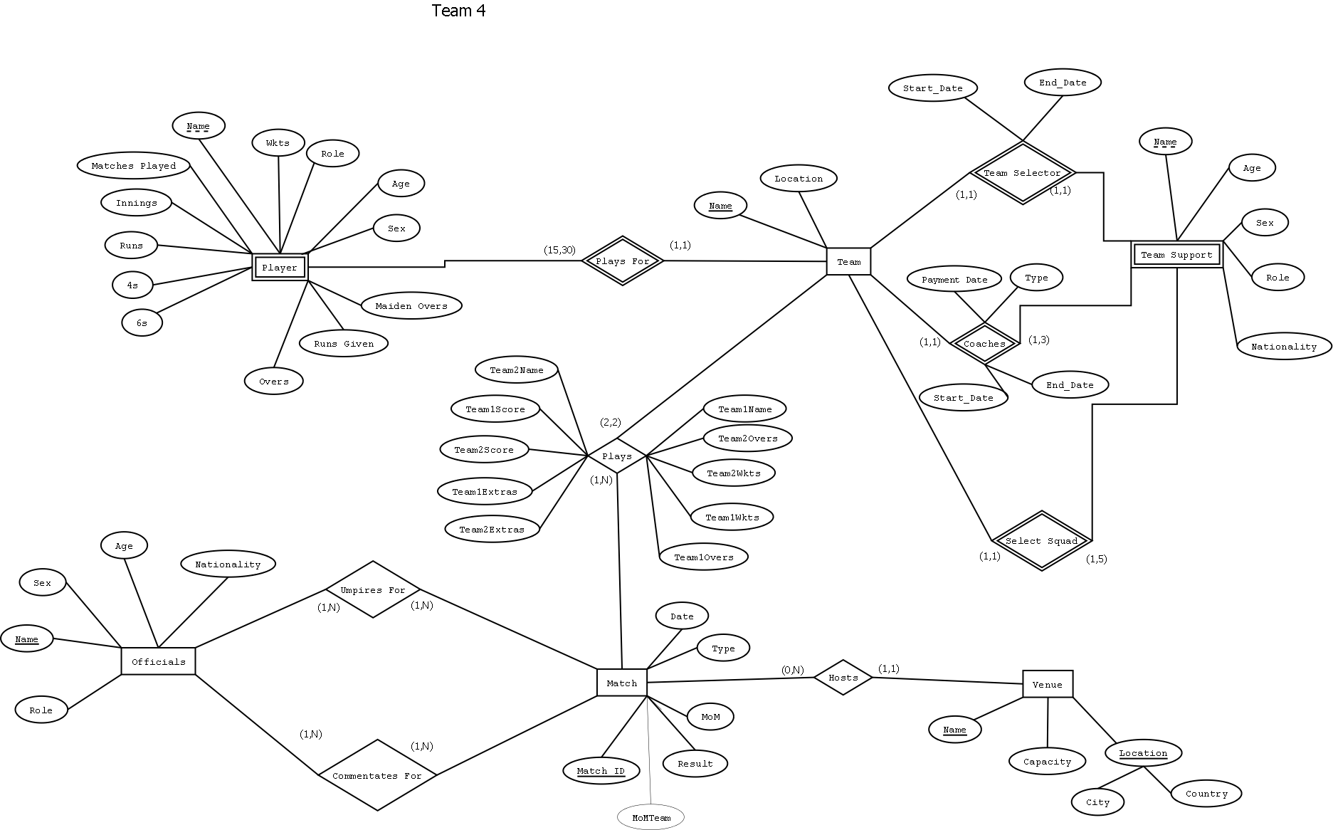
Design

Slide 5
Design Trade-offs
No support for concurrent operations in favor of consistency and isolation.
No support of Idempotent operations in favor of consistency.

Slide 6
Implementation
Live Demo

Slide 7

Questions

Slide 8
Thank you

